Slide 1
Reasoning Ability of Transformer — phenomenon-driven
Zhi-Qin John Xu 许志钦
Institute of Natural Sciences/School of Mathematical Sciences
Shanghai Jiao Tong University
Sunday, January 12, 2025

Slide 2
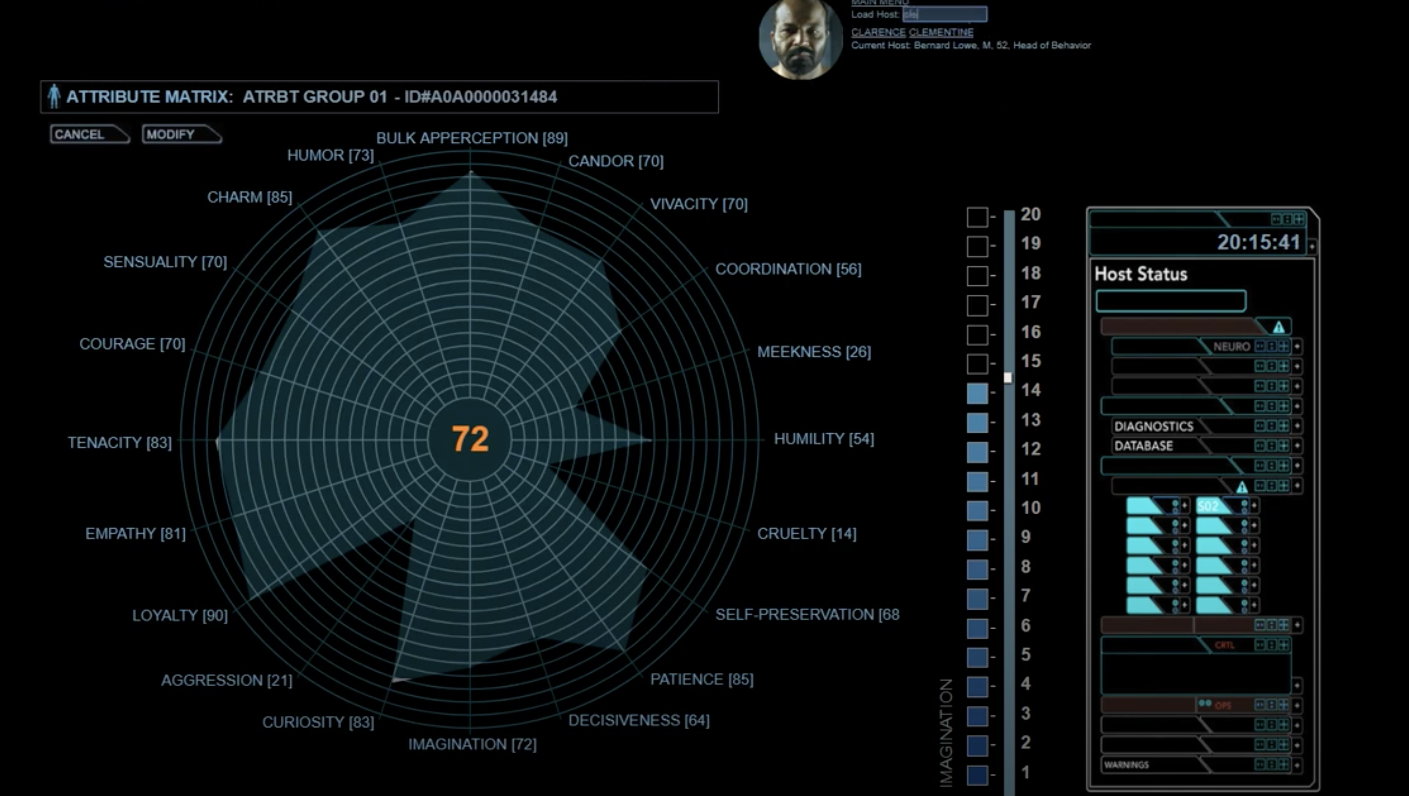
West world: control dashboard

Slide 3
What is Memorization & Reasoning?

Slide 4
What is Memorization & Reasoning?
Definition by examples.

Slide 5
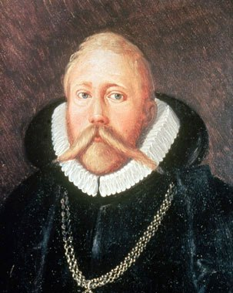
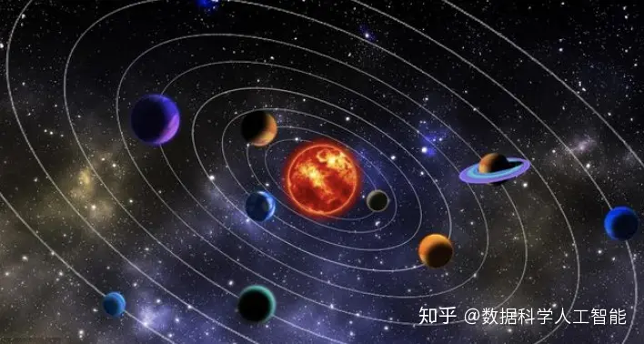
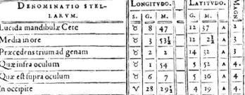
Memorization & Reasoning
Memorization
Star catalog manuscript
Tycho Brahe（1546-1601）

Slide 6
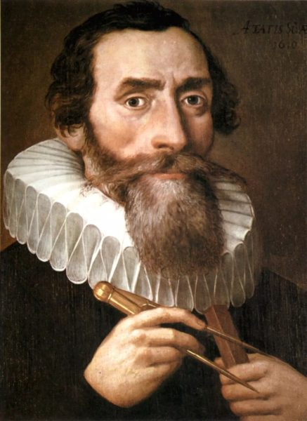
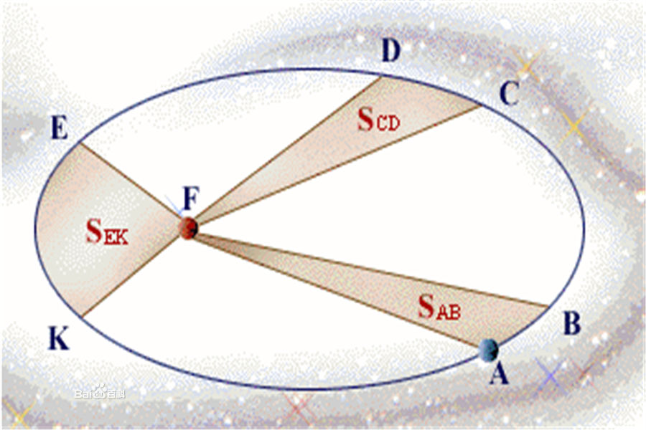
Memorization & Reasoning
Memorization
Reasoning
Kepler's Laws
Tycho Brahe（1546-1601）
Johannes Kepler （1572-1630）

Slide 7
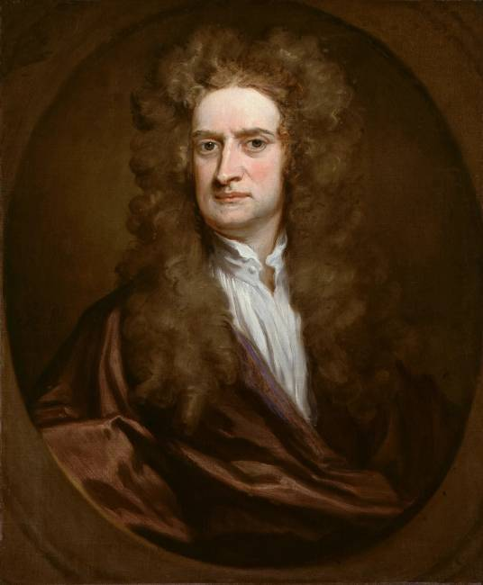
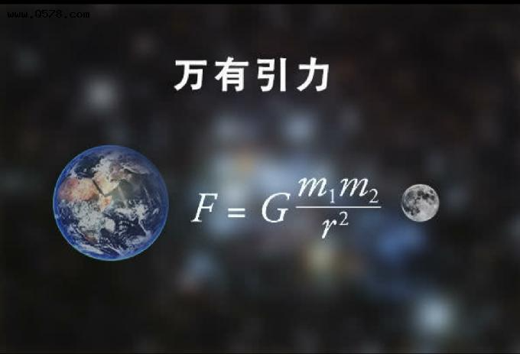
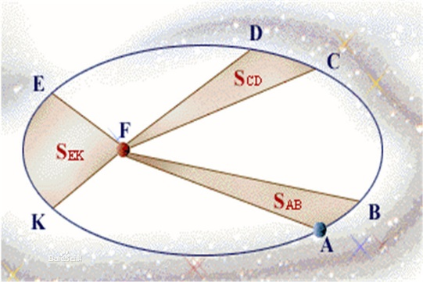
Memorization & Reasoning
Memorization
Reasoning
Reasoning+
F=ma
Tycho Brahe（1546-1601）
Johannes Kepler （1572-1630）
Isaac Newton
（1643-1727）

Slide 8
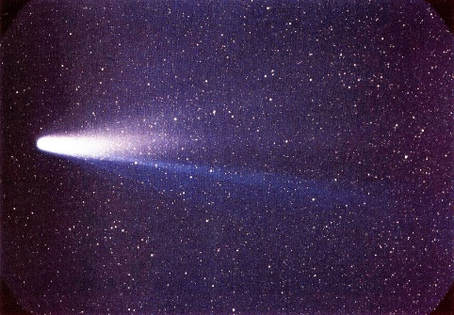
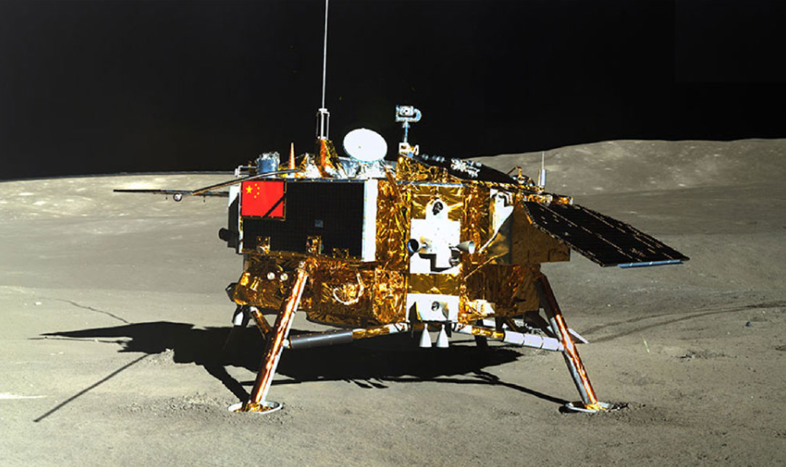


Memorization & Reasoning
Memorization
Reasoning
Reasoning+
Halley's Comet
More Application
satellite
Tycho Brahe（1546-1601）
Johannes Kepler （1572-1630）
Isaac Newton
（1643-1727）
F=ma
…

Slide 9
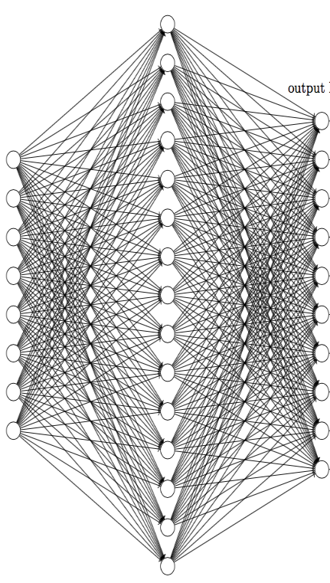


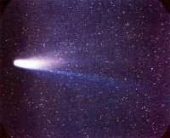
Memorization & Reasoning
NN
Memorization
No generalization
Train
To more planet data
Reasoning
F=ma
Widely used in many fields
Reasoning+

Slide 10
Difficulty in understanding
Complex
Complex
Data
Model
Can we study one by one?

Slide 11
Yes
Design a simple task to study NN.

Slide 12
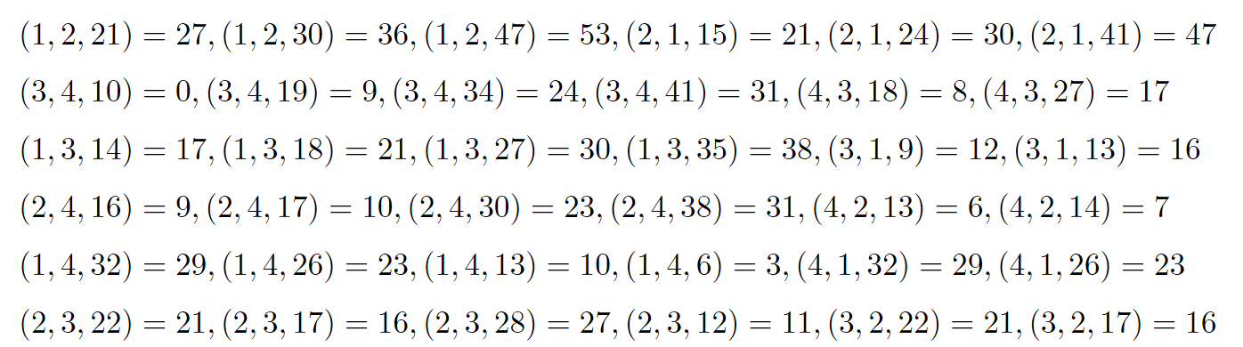
Reasoning example
Try to remember these equations and do test, e.g.,（2，1，24）=？
…
Zhongwang Zhang, Pengxiao Lin, Zhiwei Wang, Yaoyu Zhang, Zhi-Qin John Xu*, Initialization is Critical to Whether Transformers Fit Composite Functions by Inference or Memorizing, NeurIPS 2024

Slide 13
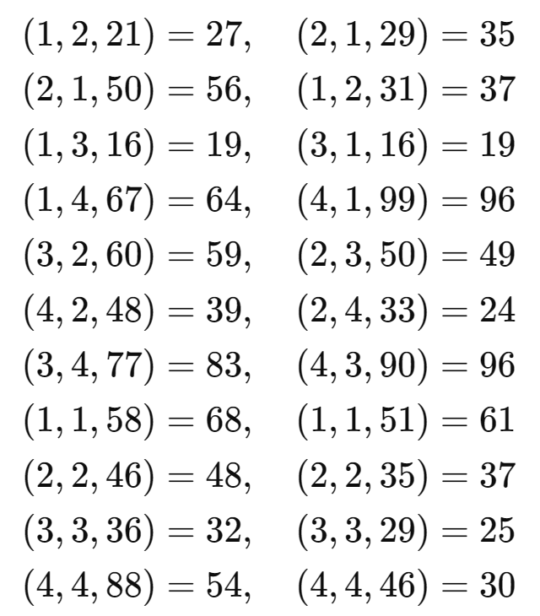
Reasoning example
Memorizing
…
Zhongwang Zhang, Pengxiao Lin, Zhiwei Wang, Yaoyu Zhang, Zhi-Qin John Xu*, Initialization is Critical to Whether Transformers Fit Composite Functions by Inference or Memorizing, NeurIPS 2024

Slide 14
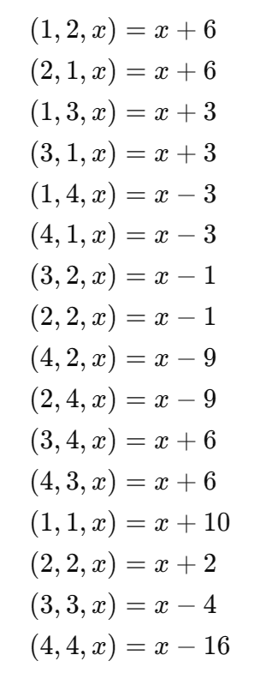
Reasoning example
Memorizing
Function relation
…
Zhongwang Zhang, Pengxiao Lin, Zhiwei Wang, Yaoyu Zhang, Zhi-Qin John Xu*, Initialization is Critical to Whether Transformers Fit Composite Functions by Inference or Memorizing, NeurIPS 2024

Slide 15
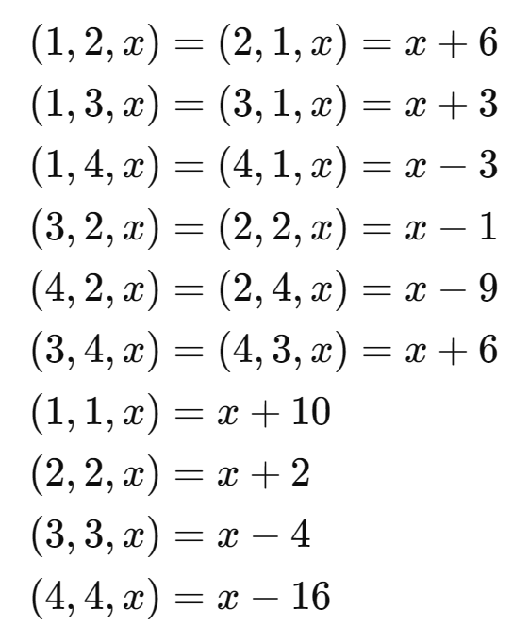
Reasoning example
Memorizing
Function relation
Symmetry
…
Zhongwang Zhang, Pengxiao Lin, Zhiwei Wang, Yaoyu Zhang, Zhi-Qin John Xu*, Initialization is Critical to Whether Transformers Fit Composite Functions by Inference or Memorizing, NeurIPS 2024

Slide 16

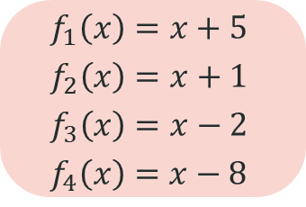
Reasoning example
How will LLM do?
Memory Complexity
Memorizing
Function relation
Reasoning Complexity
Symmetry
Composition
$$f_{1}\left(x\right)=x+5$$
$$f_{2}\left(x\right)=x+1$$
$$f_{3}\left(x\right)=x−2$$
$$f_{4}\left(x\right)=x−8$$
…
Zhongwang Zhang, Pengxiao Lin, Zhiwei Wang, Yaoyu Zhang, Zhi-Qin John Xu*, Initialization is Critical to Whether Transformers Fit Composite Functions by Inference or Memorizing, NeurIPS 2024

Slide 17
Anchor function
Designated Token as Anchor
Other Token as Key
Data set
(21, 1, 2, 27)
(29, 2, 1, 35)
(50, 2, 1, 56)
(29, 3, 3, 25)
(46, 4, 4, 30)
1
:
+5
5
Train model to predict Targets
2
:
+1
6
3
:
-2
…
…
4
:
-8
100
Key
Anchor
Target

Slide 18
NN to learn Anchor function
Loss only here
Calculate loss
Data set
NN
Output
Target
(21, 1, 2, 27)
(29, 2, 1, 35)
(50, 2, 1, 56)
(29, 3, 3, 25)
(46, 4, 4, 30)
. . .
…
5
1
2
Key
Anchor
Target
Other Token as Key
Designated Token as Anchor

Slide 19
Generalization for Anchor function
Loss only here
Calculate loss
Data generalization
Task generalization
Output
Target
This comb is not seen during training
NN
. . .
(21, 1, 2)
(21, 4, 3)
Anchor pair is seen
Anchor pair NOT seen
5
1
2
Other Token as Key
Designated Token as Anchor
Only Anchor pair (4,3) NOT seen

Slide 20
Can it learn [4,3]?
Zhongwang Zhang, Pengxiao Lin, Zhiwei Wang, Yaoyu Zhang, Zhi-Qin John Xu*, Initialization is Critical to Whether Transformers Fit Composite Functions by Inference or Memorizing, NeurIPS 2024

Slide 21
Yes, it can learn [4,3]!
Zhongwang Zhang, Pengxiao Lin, Zhiwei Wang, Yaoyu Zhang, Zhi-Qin John Xu*, Initialization is Critical to Whether Transformers Fit Composite Functions by Inference or Memorizing, NeurIPS 2024

Slide 22
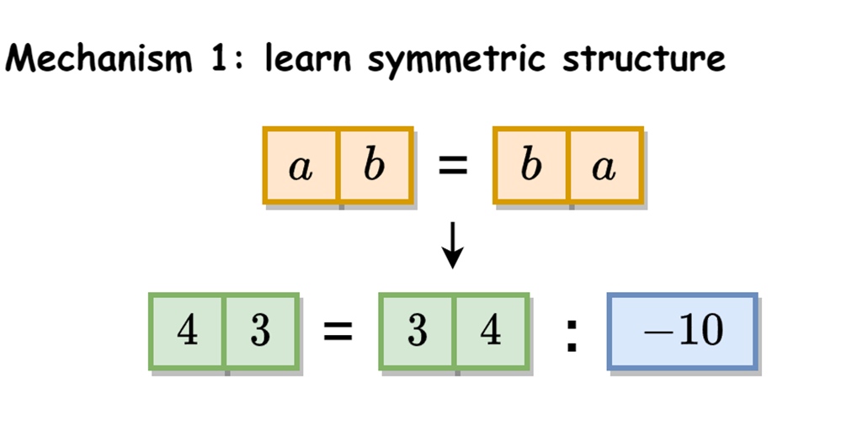
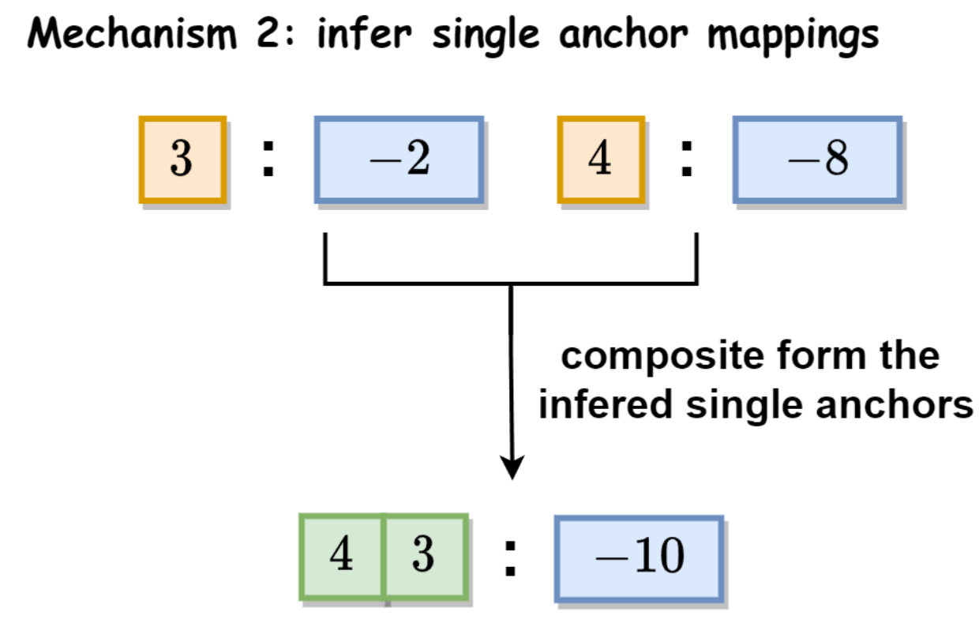
Turn your eyes to preferred answer
Symmetric or Inferential?
Zhongwang Zhang, Pengxiao Lin, Zhiwei Wang, Yaoyu Zhang, Zhi-Qin John Xu*, Initialization is Critical to Whether Transformers Fit Composite Functions by Inference or Memorizing, NeurIPS 2024

Slide 23
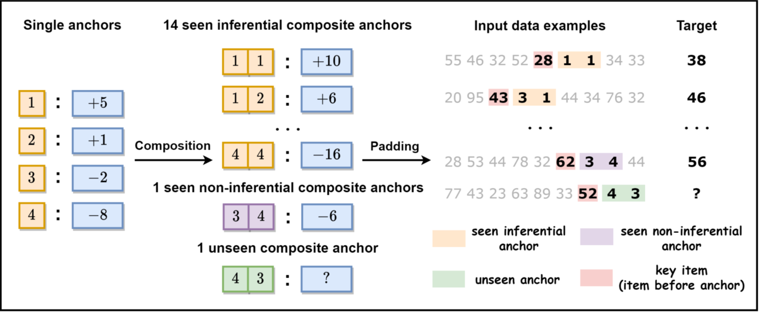
Composite Anchor function
Zhongwang Zhang, Pengxiao Lin, Zhiwei Wang, Yaoyu Zhang, Zhi-Qin John Xu*, Initialization is Critical to Whether Transformers Fit Composite Functions by Inference or Memorizing, NeurIPS 2024

Slide 24
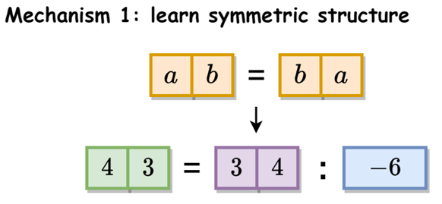
Turn your eyes to preferred answer
Symmetric or Inferential?
Zhongwang Zhang, Pengxiao Lin, Zhiwei Wang, Yaoyu Zhang, Zhi-Qin John Xu*, Initialization is Critical to Whether Transformers Fit Composite Functions by Inference or Memorizing, NeurIPS 2024

Slide 25
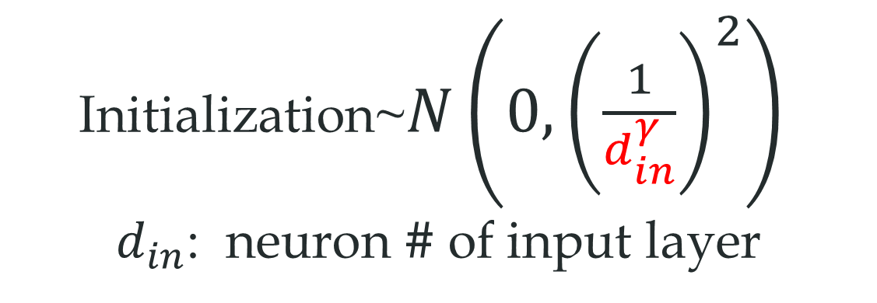
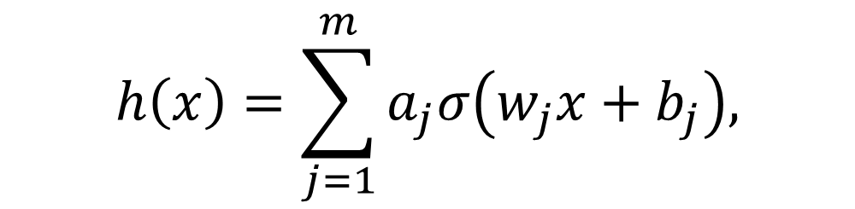
Phase diagram of symmetric solution
$$h\left(x\right)=\sum_{j=1}^{m}{a_{j}σ\left(w_{j}x+b_{j}\right),}$$
Initialization~$N\left(0,{\left(\frac{1}{d_{in}^{γ}}\right)}^{2}\right)$
$d_{in}$: neuron # of input layer
Zhongwang Zhang, Pengxiao Lin, Zhiwei Wang, Yaoyu Zhang, Zhi-Qin John Xu*, Initialization is Critical to Whether Transformers Fit Composite Functions by Inference or Memorizing, NeurIPS 2024

Slide 26
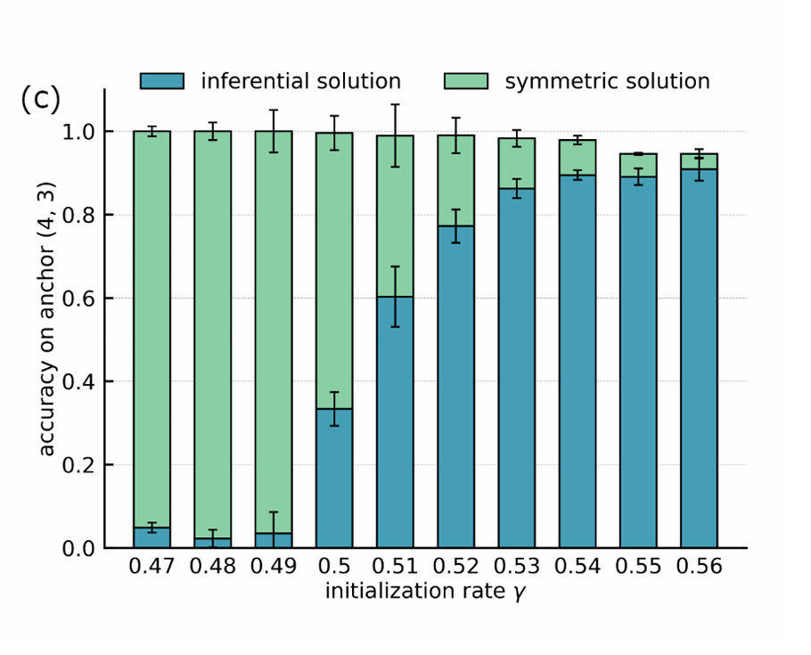
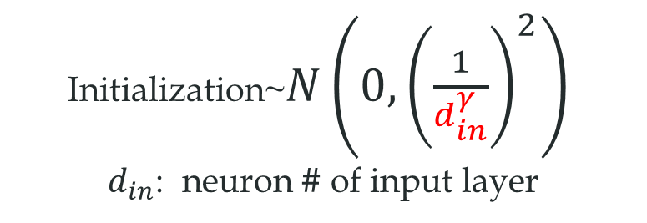
Phase diagram of symmetric solution
Initialization~$N\left(0,{\left(\frac{1}{d_{in}^{γ}}\right)}^{2}\right)$
$d_{in}$: neuron # of input layer
Large ini
Small ini
Zhongwang Zhang, Pengxiao Lin, Zhiwei Wang, Yaoyu Zhang, Zhi-Qin John Xu*, Initialization is Critical to Whether Transformers Fit Composite Functions by Inference or Memorizing, NeurIPS 2024

Slide 27
Inference example
Memorizing
Function relation
How will LLM do?
Symmetry
Composition
$$f_{1}\left(x\right)=x+5$$
$$f_{2}\left(x\right)=x+1$$
$$f_{3}\left(x\right)=x−2$$
$$f_{4}\left(x\right)=x−8$$
…
Zhongwang Zhang, Pengxiao Lin, Zhiwei Wang, Yaoyu Zhang, Zhi-Qin John Xu*, Initialization is Critical to Whether Transformers Fit Composite Functions by Inference or Memorizing, NeurIPS 2024

Slide 28
16 compositions
[3,4]，[4,3] unseen during training

Slide 29
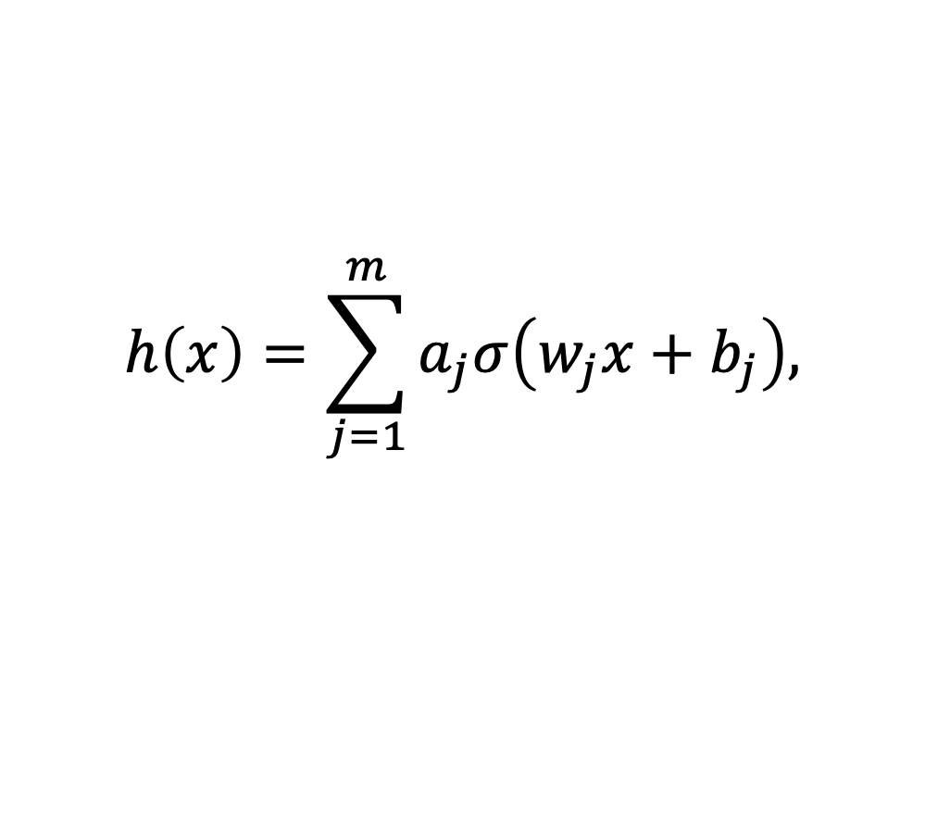
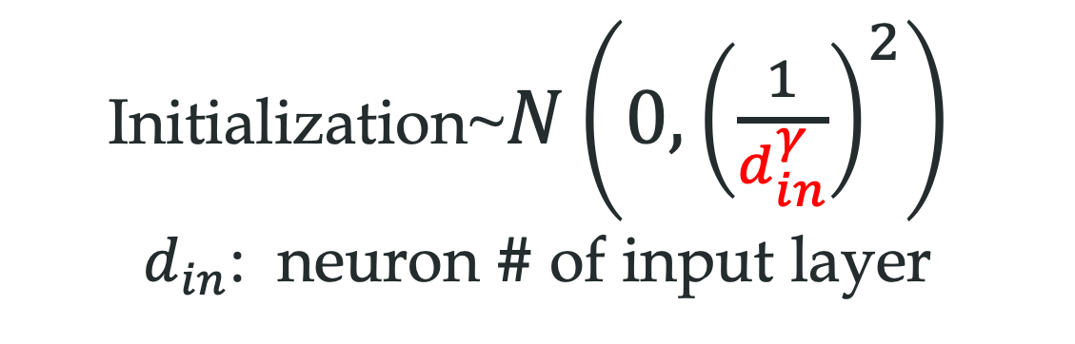
Initialization hyper-parameter！
$$h\left(x\right)=\sum_{j=1}^{m}{a_{j}σ\left(w_{j}x+b_{j}\right),}$$
Training：Start from random initialization
Initialization~$N\left(0,{\left(\frac{1}{d_{in}^{γ}}\right)}^{2}\right)$
$d_{in}$: neuron # of input layer
Zhongwang Zhang, Pengxiao Lin, Zhiwei Wang, Yaoyu Zhang, Zhi-Qin John Xu*, Initialization is Critical to Whether Transformers Fit Composite Functions by Inference or Memorizing, NeurIPS 2024

Slide 30
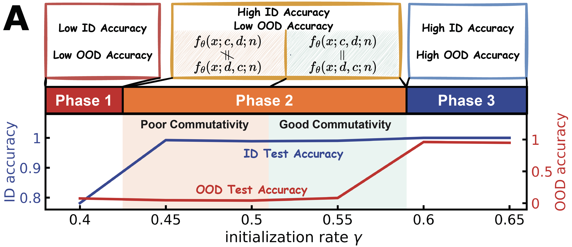
Without 34 and 43
ID: Seen anchors; OOD: unseen anchors
Memorize data.
Zhongwang Zhang, Pengxiao Lin, Zhiwei Wang, Yaoyu Zhang, Zhi-Qin John Xu*, Complexity Control Facilitates Reasoning-Based Compositional Generalization in Transformers, arXiv

Slide 31
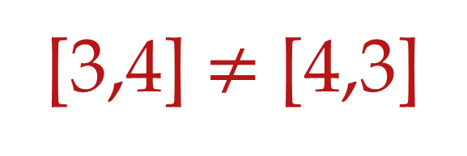
Without 34 and 43
ID: Seen anchors; OOD: unseen anchors
Generalize on seen tasks but not unseen ones.
[3,4] $≠$ [4,3]
Zhongwang Zhang, Pengxiao Lin, Zhiwei Wang, Yaoyu Zhang, Zhi-Qin John Xu*, Complexity Control Facilitates Reasoning-Based Compositional Generalization in Transformers, arXiv

Slide 32
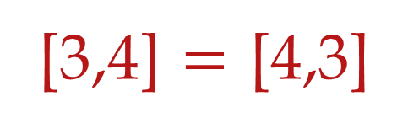
Without 34 and 43
ID: Seen anchors; OOD: unseen anchors
Generalize on seen tasks but not unseen ones.
[3,4] $=$ [4,3]
Zhongwang Zhang, Pengxiao Lin, Zhiwei Wang, Yaoyu Zhang, Zhi-Qin John Xu*, Complexity Control Facilitates Reasoning-Based Compositional Generalization in Transformers, arXiv

Slide 33
Without 34 and 43
ID: Seen anchors; OOD: unseen anchors
Zhongwang Zhang, Pengxiao Lin, Zhiwei Wang, Yaoyu Zhang, Zhi-Qin John Xu*, Complexity Control Facilitates Reasoning-Based Compositional Generalization in Transformers, arXiv

Slide 34
Why initialization matters?
Zhongwang Zhang, Pengxiao Lin, Zhiwei Wang, Yaoyu Zhang, Zhi-Qin John Xu*, Initialization is Critical to Whether Transformers Fit Composite Functions by Inference or Memorizing, NeurIPS 2024

Slide 35
Key phenomenon: Condensation!
Zhongwang Zhang, Pengxiao Lin, Zhiwei Wang, Yaoyu Zhang, Zhi-Qin John Xu*, Initialization is Critical to Whether Transformers Fit Composite Functions by Inference or Memorizing, NeurIPS 2024

Slide 36
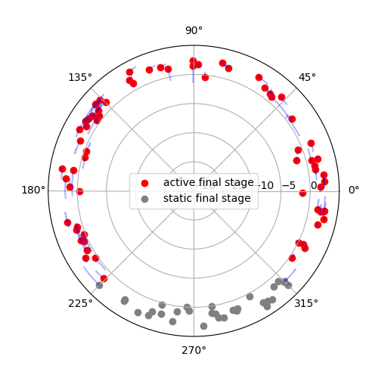
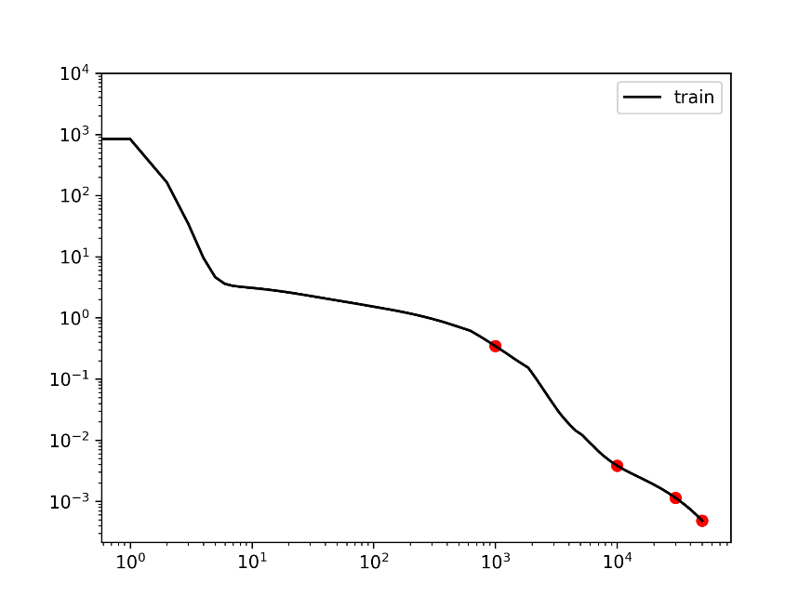
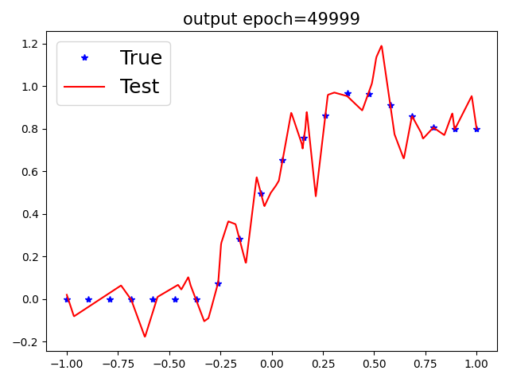



1d example: condensation with large initialization
$$f_{θ}\left(x\right)=\sum_{j=1}^{m}{a_{j}σ{(w_{j}x+b_{j})}}$$
$$b$$
$$w$$
Epoch=50000
Tao Luo#, Zhi-Qin John Xu #, Zheng Ma, Yaoyu Zhang*,
Phase diagram for two-layer ReLU neural networks at infinite-width limit, Journal of Machine Learning Research (2021)

Slide 37
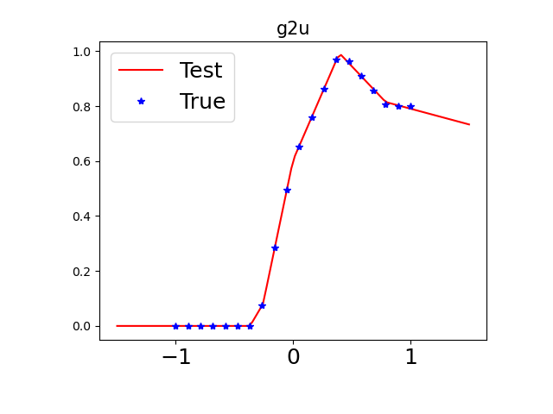
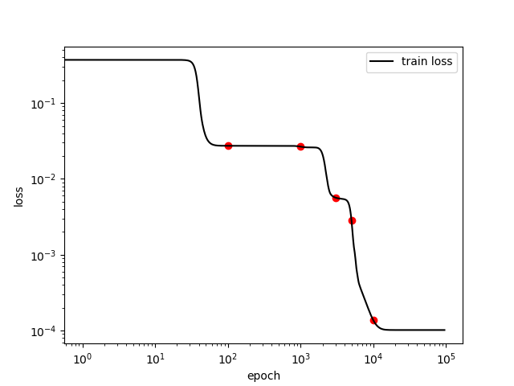
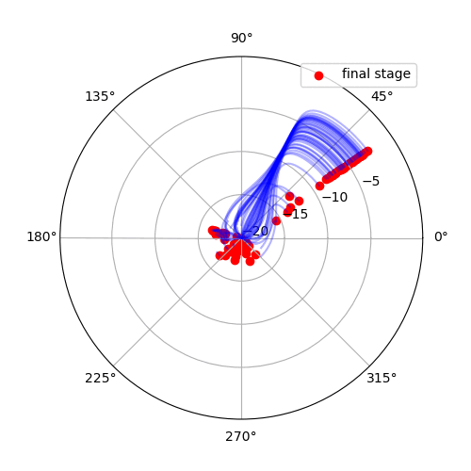
1d example: condensation with small initialization
$$f_{θ}\left(x\right)=\sum_{j=1}^{m}{a_{j}σ{(w_{j}x+b_{j})}}$$
$$b$$
$$w$$
Tao Luo#, Zhi-Qin John Xu #, Zheng Ma, Yaoyu Zhang*,
Phase diagram for two-layer ReLU neural networks at infinite-width limit, Journal of Machine Learning Research (2021)

Slide 38
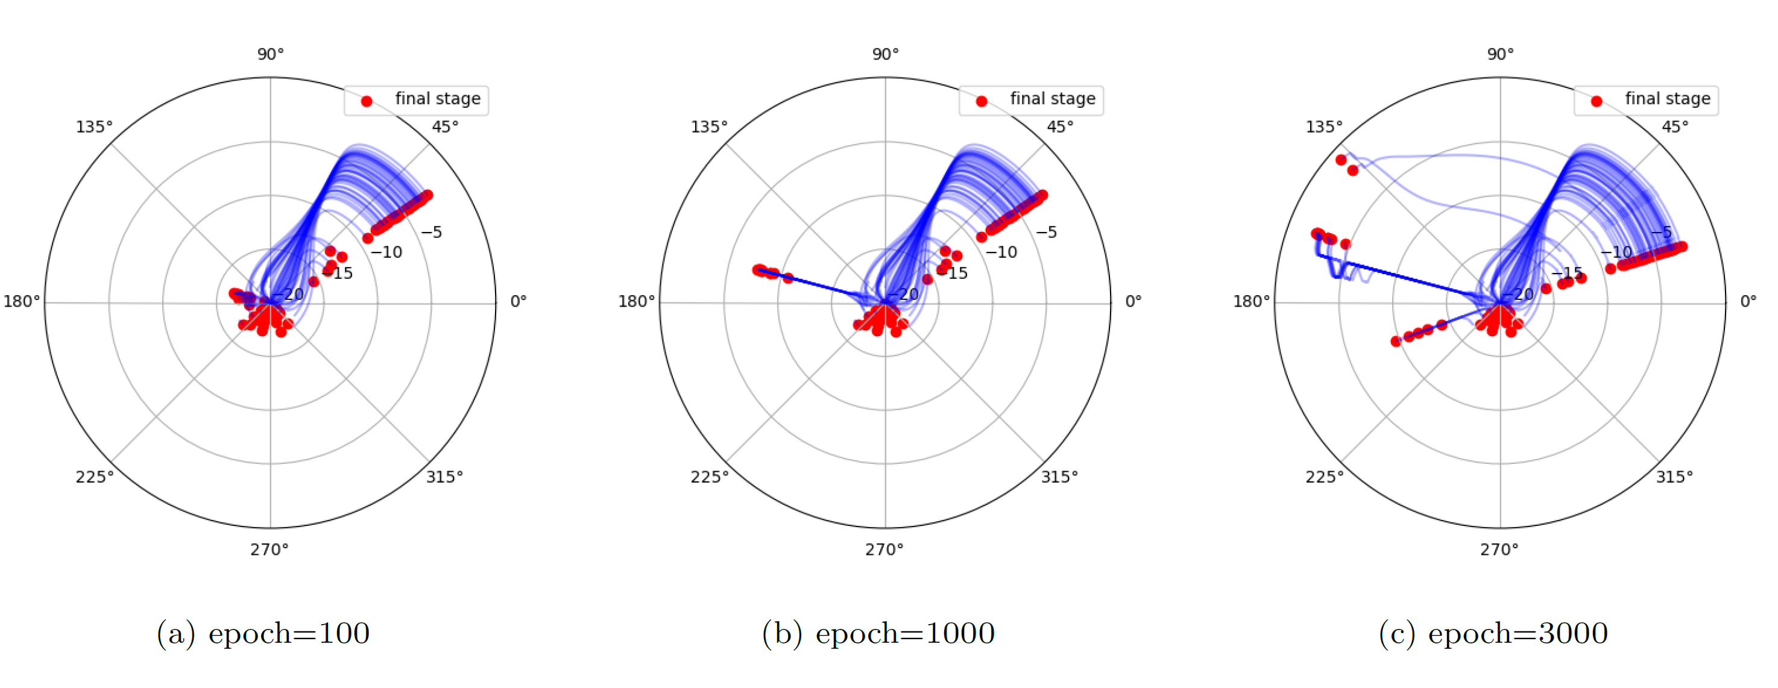
Evolution trajectory: change significantly
Tao Luo#, Zhi-Qin John Xu #, Zheng Ma, Yaoyu Zhang*,
Phase diagram for two-layer ReLU neural networks at infinite-width limit, Journal of Machine Learning Research (2021)

Slide 39
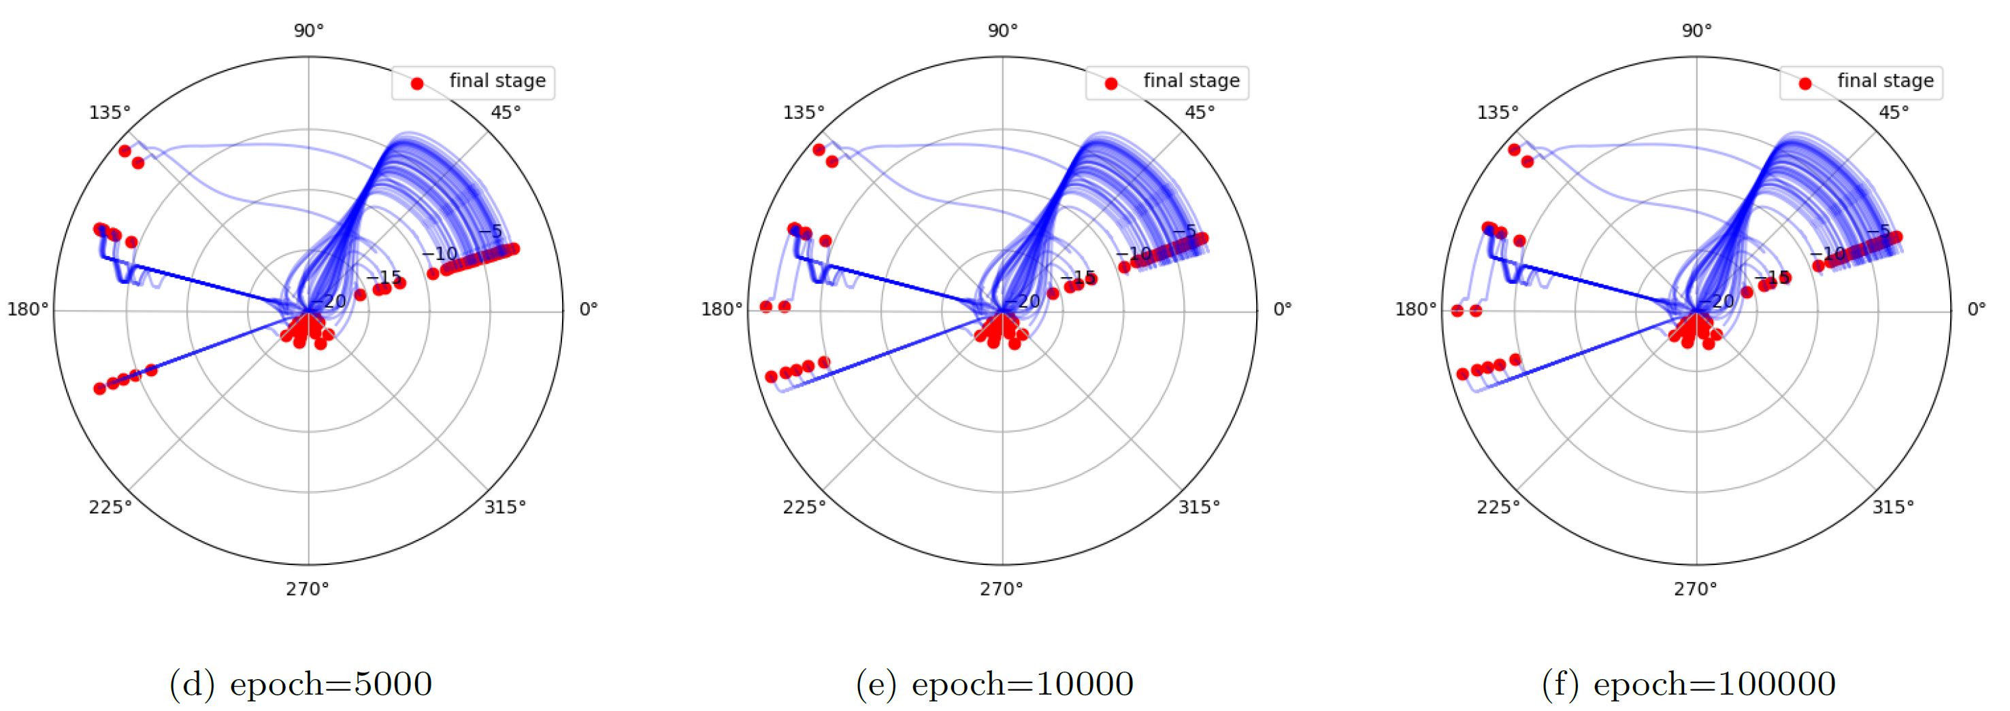
Evolution trajectory: change significantly
Tao Luo#, Zhi-Qin John Xu #, Zheng Ma, Yaoyu Zhang*,
Phase diagram for two-layer ReLU neural networks at infinite-width limit, Journal of Machine Learning Research (2021)

Slide 40
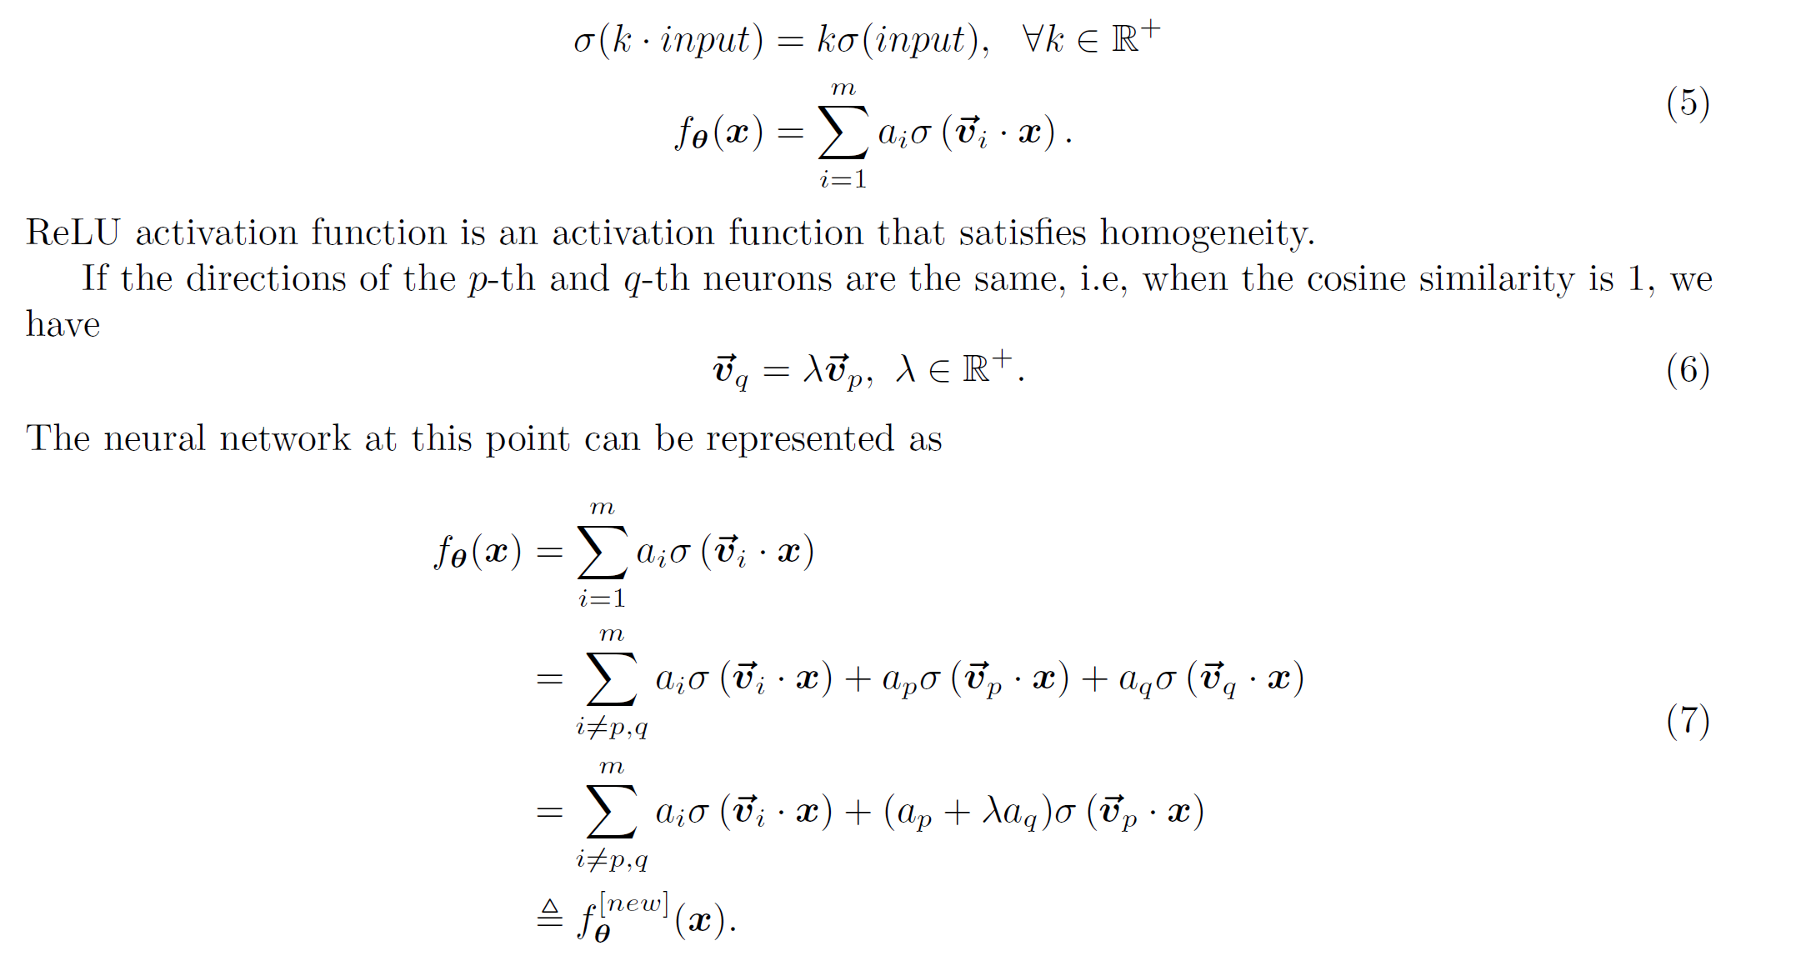
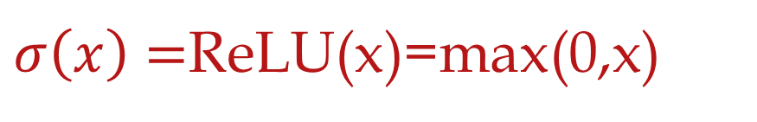
Condensation reduction method
$σ\left(x\right)=$ReLU(x)=max(0,x)

Slide 41
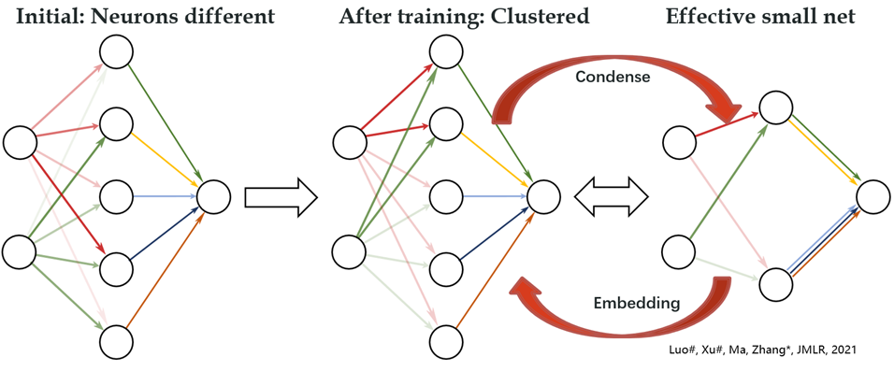

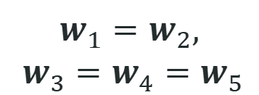
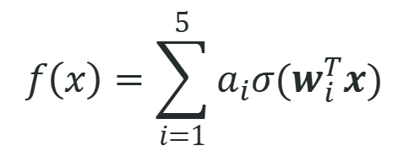
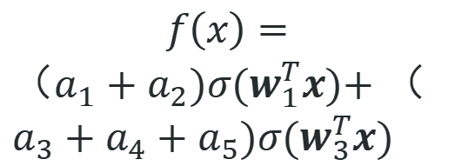
Condensation with small initialization
$$f\left(x\right)=\sum_{i=1}^{5}{a_{i}σ(w_{i}^{T}x)}$$
$$f\left(x\right)=$$
$（a_{1}+a_{2})σ(w_{1}^{T}x)\text{+}$ $（a_{3}+a_{4}+a_{5})σ(w_{3}^{T}x)$
$$w_{1}^{ }=w_{2}^{ },$$
$${ w}_{3}^{ }=w_{4}^{ }=w_{5}^{ }$$
Initial：random
After training：
Condense
Effective：
Small net
Luo#, Xu#, Ma, Zhang*, 2007.07497, JMLR; Zhou, Zhou, Jin Luo, Zhang*, Xu*, NeurIPS 2022

Slide 42
Small vs. large initialization
$$f_{θ}\left(x\right)=\sum_{j=1}^{m}{a_{j}σ{(w_{j}x+b_{j})}}$$
small initialization
large initialization
Tao Luo#, Zhi-Qin John Xu #, Zheng Ma, Yaoyu Zhang*,
Phase diagram for two-layer ReLU neural networks at infinite-width limit, Journal of Machine Learning Research (2021)

Slide 43
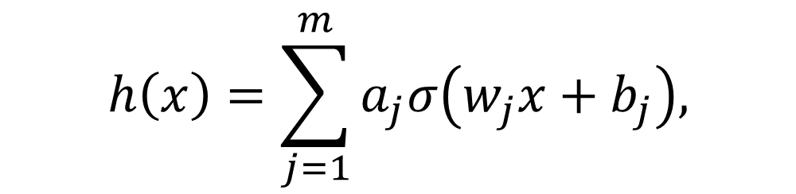
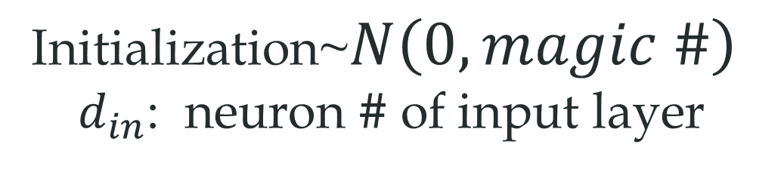
How small? How large?
$$h\left(x\right)=\sum_{j=1}^{m}{a_{j}σ\left(w_{j}x+b_{j}\right),}$$
Deep Net
Initialization~$N\left(0,magic \#\right)$
$d_{in}$: neuron # of input layer

Slide 44
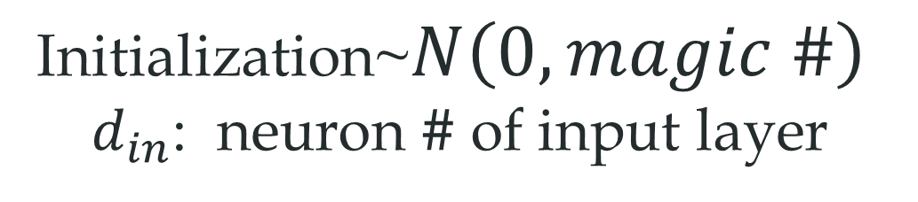
How small? How large?
$$h\left(x\right)=\sum_{j=1}^{m}{a_{j}σ\left(w_{j}x+b_{j}\right),}$$
Smaller
Initialization~$N\left(0,magic \#\right)$
$d_{in}$: neuron # of input layer

Slide 45
How small? How large?
$$h\left(x\right)=\sum_{j=1}^{m}{a_{j}σ\left(w_{j}x+b_{j}\right),}$$
Larger
Initialization~$N\left(0,magic \#\right)$
$d_{in}$: neuron # of input layer

Slide 46
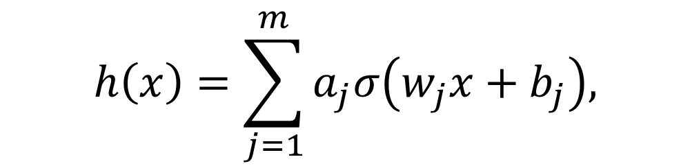

Parameter initialization
$$h\left(x\right)=\sum_{j=1}^{m}{a_{j}σ\left(w_{j}x+b_{j}\right),}$$
Initialization~$N\left(0,{\left(\frac{1}{d_{in}^{γ}}\right)}^{2}\right)$
$d_{in}$: neuron # of input layer
Luo#, Xu#, Ma, Zhang*, 2007.07497, JMLR; Zhou, Zhou, Jin Luo, Zhang*, Xu*, NeurIPS 2022

Slide 47
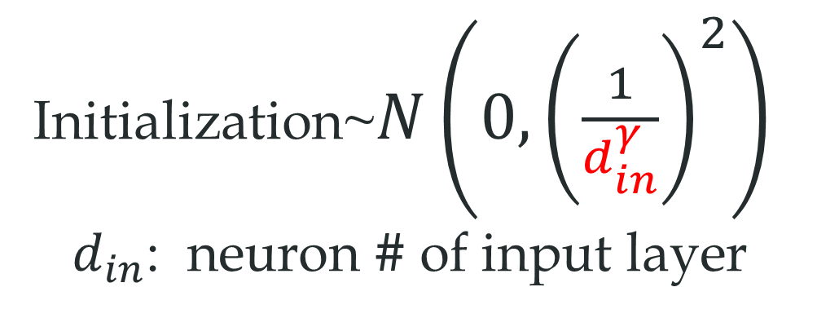

Parameter initialization
$$h\left(x\right)=\sum_{j=1}^{m}{a_{j}σ\left(w_{j}x+b_{j}\right),}$$
Initialization~$N\left(0,{\left(\frac{1}{d_{in}^{γ}}\right)}^{2}\right)$
$d_{in}$: neuron # of input layer
Thm: For different network sizes,
$γ$ stays the same
→
similar behavior
Luo#, Xu#, Ma, Zhang*, 2007.07497, JMLR; Zhou, Zhou, Jin Luo, Zhang*, Xu*, NeurIPS 2022

Slide 48
Condensation in Transformer!
Zhongwang Zhang, Pengxiao Lin, Zhiwei Wang, Yaoyu Zhang, Zhi-Qin John Xu*, Initialization is Critical to Whether Transformers Fit Composite Functions by Inference or Memorizing, NeurIPS 2024

Slide 49


Transformer
Zhongwang Zhang, Pengxiao Lin, Zhiwei Wang, Yaoyu Zhang, Zhi-Qin John Xu*, Initialization is Critical to Whether Transformers Fit Composite Functions by Inference or Memorizing, NeurIPS 2024

Slide 50




Condensation of $W^{Q(1)}$ by column
$$X^{(1)}$$
output: $Q^{(1)}$
$$W^{Q(1)}$$
Cosine Similarity b/w Columns of $W^{Q(1)}$
Each column is the weight of a neuron
If all columns are the same, what then?
Few effective neurons!
Zhongwang Zhang, Pengxiao Lin, Zhiwei Wang, Yaoyu Zhang, Zhi-Qin John Xu*, Initialization is Critical to Whether Transformers Fit Composite Functions by Inference or Memorizing, NeurIPS 2024

Slide 51

Condensation of $W^{Q(1)}$ by column
$$X^{(1)}$$
output: $Q^{(1)}$
$$W^{Q(1)}$$
Cosine Similarity b/w Columns of $W^{Q(1)}$
Each column is the weight of a neuron
Small ini: clear condensation
Large ini: no condensation
Zhongwang Zhang, Pengxiao Lin, Zhiwei Wang, Yaoyu Zhang, Zhi-Qin John Xu*, Initialization is Critical to Whether Transformers Fit Composite Functions by Inference or Memorizing, NeurIPS 2024

Slide 52
Zhongwang Zhang, Pengxiao Lin, Zhiwei Wang, Yaoyu Zhang, Zhi-Qin John Xu*, Initialization is Critical to Whether Transformers Fit Composite Functions by Inference or Memorizing, NeurIPS 2024

Slide 53


Structural Features of the Word Embedding
T-SNE
Small ini: clear structure
Large ini: no structure
$$f_{a}(x)=\left\{\begin{aligned}x+5, if a =1 \\ x+1, if a =2 \\ x−2, if a =3 \\ x−8, if a =4\end{aligned}\right.$$
Zhongwang Zhang, Pengxiao Lin, Zhiwei Wang, Yaoyu Zhang, Zhi-Qin John Xu*, Initialization is Critical to Whether Transformers Fit Composite Functions by Inference or Memorizing, NeurIPS 2024

Slide 54
Mechanisms underlying initialization effect
Low complexity as possible
Only learn
four anchor
Generalize
on inference
Small initial
Condense
Vey slight
condense
Large
complexity
Easily fit ten
sym. maps
Generalize
on sym. map
Large initial
Very
Large initial
No
condense
Very large
complexity
Easily all
fit maps
No Generalize
Zhongwang Zhang, Pengxiao Lin, Zhiwei Wang, Yaoyu Zhang, Zhi-Qin John Xu*, Initialization is Critical to Whether Transformers Fit Composite Functions by Inference or Memorizing, NeurIPS 2024

Slide 55
Does the net learn each anchor mapping?
Zhongwang Zhang, Pengxiao Lin, Zhiwei Wang, Yaoyu Zhang, Zhi-Qin John Xu*, Initialization is Critical to Whether Transformers Fit Composite Functions by Inference or Memorizing, NeurIPS 2024

Slide 56

Remove one anchor
Zhongwang Zhang, Pengxiao Lin, Zhiwei Wang, Yaoyu Zhang, Zhi-Qin John Xu*, Complexity Control Facilitates Reasoning-Based Compositional Generalization in Transformers, arXiv

Slide 57

Remove one anchor
Use one representation for one result
Zhongwang Zhang, Pengxiao Lin, Zhiwei Wang, Yaoyu Zhang, Zhi-Qin John Xu*, Complexity Control Facilitates Reasoning-Based Compositional Generalization in Transformers, arXiv

Slide 58

Prediction
inferential complexity (IC): #(non-inferential group) keeping symmetry
EX:
$f\left(x;1,1\right)=x+10$, $f\left(x;1,2\right)=f\left(x;2,1\right)=x+6$, $f\left(x;1,3\right)=f\left(x;3,1\right)=x+3$, $f\left(x;1,4\right)=f\left(x;4,1\right)=x−3$
$f\left(x;2,2\right)=x+2$, $f\left(x;2,3\right)=f\left(x;3,2\right)=x−1$, $f\left(x;2,4\right)=f\left(x;4,2\right)=x−7$
$f\left(x;3,3\right)=x−4$, $f\left(x;3,4\right)=f\left(x;4,3\right)=x−10$
$f\left(x;4,4\right)=f\left(x;4,4\right)=x−16$
Zhongwang Zhang, Pengxiao Lin, Zhiwei Wang, Yaoyu Zhang, Zhi-Qin John Xu*, Initialization is Critical to Whether Transformers Fit Composite Functions by Inference or Memorizing, NeurIPS 2024

Slide 59

Prediction
inferential complexity (IC): #(non-inferential group) keeping symmetry
EX:
$f\left(x;1,1\right)=x+5$, $f\left(x;1,2\right)=f\left(x;2,1\right)=x−5$, $f\left(x;1,3\right)=f\left(x;3,1\right)=x+3$, $f\left(x;1,4\right)=f\left(x;4,1\right)=x−3$
$f\left(x;2,2\right)=x+2$, $f\left(x;2,3\right)=f\left(x;3,2\right)=x+2$, $f\left(x;2,4\right)=f\left(x;4,2\right)=x−7$
$f\left(x;3,3\right)=x−4$, $f\left(x;3,4\right)=f\left(x;4,3\right)=x−10$
$f\left(x;4,4\right)=f\left(x;4,4\right)=x−16$
IC=3
Low complexity as possible
Larger IC
More steps
Small initial
Condense
Vey slight
condense
Large
complexity
ten sym. maps
for any IC
Similar steps for any IC
Large initial
Zhongwang Zhang, Pengxiao Lin, Zhiwei Wang, Yaoyu Zhang, Zhi-Qin John Xu*, Initialization is Critical to Whether Transformers Fit Composite Functions by Inference or Memorizing, NeurIPS 2024

Slide 60

Prediction verified!
Low complexity as possible
Larger IC
More steps
Small initial
Condense
Vey slight
condense
Large
complexity
ten sym. maps
for any IC
Similar steps for any IC
Large initial
Small initial
Large initial
Zhongwang Zhang, Pengxiao Lin, Zhiwei Wang, Yaoyu Zhang, Zhi-Qin John Xu*, Initialization is Critical to Whether Transformers Fit Composite Functions by Inference or Memorizing, NeurIPS 2024

Slide 61
Complexity restriction is the key!

Slide 62

Effect of weight decay and lr
Large wd + large lr (within a certain range)
Condense
Inferential solution
Zhongwang Zhang, Pengxiao Lin, Zhiwei Wang, Yaoyu Zhang, Zhi-Qin John Xu*, Initialization is Critical to Whether Transformers Fit Composite Functions by Inference or Memorizing, NeurIPS 2024

Slide 63
Verification in more experiments!

Slide 64


Diffusion model
failure mode
010
011
Okawa 2024, NeurIPS 2024
Zhongwang Zhang, Pengxiao Lin, Zhiwei Wang, Yaoyu Zhang, Zhi-Qin John Xu*, Complexity Control Facilitates Reasoning-Based Compositional Generalization in Transformers, arXiv

Slide 65
Diffusion model
Zhongwang Zhang, Pengxiao Lin, Zhiwei Wang, Yaoyu Zhang, Zhi-Qin John Xu*, Complexity Control Facilitates Reasoning-Based Compositional Generalization in Transformers, arXiv

Slide 66

Other realistic compositional dataset
SCAN IN: turn right after jump twice OUT: I_JUMP I_JUMP I_TURN_RIGHT
COGS IN: A cake rolled . OUT: cake ( x _ 1 ) AND roll . theme ( x _ 2 , x _ 1 )
I.D: Generalization of different combinations of primitives
O.O.D: Generalization of specific primitives to unseen sentence patterns
Zhongwang Zhang, Pengxiao Lin, Zhiwei Wang, Yaoyu Zhang, Zhi-Qin John Xu*, Initialization is Critical to Whether Transformers Fit Composite Functions by Inference or Memorizing, NeurIPS 2024

Slide 67

SlimPajama
Different initialization
GPT-2 Medium + 33B GitHub section (&22B Wikipedia section) of SlimPajama
Zhongwang Zhang, Pengxiao Lin, Zhiwei Wang, Yaoyu Zhang, Zhi-Qin John Xu*, Initialization is Critical to Whether Transformers Fit Composite Functions by Inference or Memorizing, NeurIPS 2024

Slide 68

Addition task
Addition: $a+b=c, a, b∈ [0, 999]$. Test on $a, b∈ [400, 600]$, train on the other data.
Zhongwang Zhang, Pengxiao Lin, Zhiwei Wang, Yaoyu Zhang, Zhi-Qin John Xu*, Initialization is Critical to Whether Transformers Fit Composite Functions by Inference or Memorizing, NeurIPS 2024

Slide 69

Other realistic reasoning dataset
More data, more steps to memorize
Zhongwang Zhang, Pengxiao Lin, Zhiwei Wang, Yaoyu Zhang, Zhi-Qin John Xu*, Initialization is Critical to Whether Transformers Fit Composite Functions by Inference or Memorizing, NeurIPS 2024

Slide 70


Test on Memory^ 3 LLM (Focus on abstract and rule)
small initialization + large weight decay, 0.8B Model + 100B Data
Score increment: 7.5%
Empirically, 5%=2 * #para, effective scale is 2.8 of original initialization.
Math and professional test are more significant
Large ini
Small WD
Small ini
Large WD
Hongkang Yang, Weinan E etc., Memory^3: Language Modeling with Explicit Memory. arXiv preprint arXiv:2407.01178 (2024).
Zhongwang Zhang, Pengxiao Lin, Zhiwei Wang, Yaoyu Zhang, Zhi-Qin John Xu*, Initialization is Critical to Whether Transformers Fit Composite Functions by Inference or Memorizing, NeurIPS 2024

Slide 71
Implicitly bias toward simple function
Advantage of frequency principle and condensation：
Rigorous theoretical analysis
Inspire more efficient algorithms
Simple but explain overparameterization puzzle
Traditional methods
(#para>#sample)
Neural networks
can
Bias towards
overfit
Simple
High-freq！
Large-complexity！
Low-freq！
Small effective neuron #！

Slide 72
What is deep learning?

Slide 73






Linear regression
Data set:
Model:
$$h_{i}=wx_{i}+b$$
Loss/Risk:
Empirical risk minimization:
$$\min_{w,b}{L_{S}}$$
Generalization error: loss on test data set (not for training)

Slide 74

Linear regression
Data set:
Model:
$$h_{i}=wx_{i}+b$$
?
Loss/Risk:
Empirical risk minimization:
$$\min_{w,b}{L_{S}}$$
Generalization error: loss on test data set (not for training)

Slide 75

Neural network regression
Data set:
Model:
$h_{i}=\sum_{j}{a_{j}σ(w_{j}x_{i}+b_{j})}$ $σ\left(x\right):$ non-linear
Loss/Risk:
Empirical risk minimization:
$$\min_{w,b}{L_{S}}$$
Generalization error: loss on test data set (not for training)

Slide 76
It is so powerful, why bother theory?

Slide 77
Why need theory for DNN
First law of thermodynamics: Conservation of energy
Perpetual motion machine of the first kind is impossible, avoid wasting energy
Chemistry
Alchemy, copper into gold impossible, avoid wasting energy
wood carbon into diamond (high temperature and pressure) possible
Understand what DNNs are good at and what is difficult for them
Example: High frequency is difficult
Question: Does emergence necessarily require large models and big data

Slide 78
What is a good theory
Basic criteria：
revealing interesting phenomena or theoretical questions
simple enough for analysis investigate yet complex enough to illuminate issues
Verified by experiments
Advanced criteria：
Leading to more interesting phenomena or theories
Guiding for designing algorithms

Slide 79

Phenomenon-driven for deep learning
We cover the following topics:
Introduction to Phenomenon-driven understanding
Low-frequency bias in output space during training (frequency principle/spectral bias)
Neurons in the same layer tend to be similar during training (neuron condensation/alignment)
Reasoning of transformer-based language models
《深度学习导论与理解》
https://ins.sjtu.edu.cn/people/xuzhiqin/

Slide 80

Phenomenon-driven for deep learning
Frequency Principle
Condensation
anchor function to study LLM
Small ini → inference
Large ini → memorization
《深度学习导论与理解》
Initialization~$N\left(0,{\left(\frac{1}{d_{in}^{γ}}\right)}^{2}\right)$
$d_{in}$: neuron # of input layer
https://ins.sjtu.edu.cn/people/xuzhiqin/

Slide 81

Without 34 and 43
Memorizing
Function relation
Symmetry
Composition

Slide 82
Mechanism difference in Attention!

Slide 83

Information flow via attention

Slide 84



Symmetric solution
Zhongwang Zhang, Pengxiao Lin, Zhiwei Wang, Yaoyu Zhang, Zhi-Qin John Xu*, Initialization is Critical to Whether Transformers Fit Composite Functions by Inference or Memorizing, NeurIPS 2024

Slide 85



Inferential solution
Zhongwang Zhang, Pengxiao Lin, Zhiwei Wang, Yaoyu Zhang, Zhi-Qin John Xu*, Initialization is Critical to Whether Transformers Fit Composite Functions by Inference or Memorizing, NeurIPS 2024

Slide 86

$V^{(2)}$Representation
Each anchor represents a function
Zhongwang Zhang, Pengxiao Lin, Zhiwei Wang, Yaoyu Zhang, Zhi-Qin John Xu*, Initialization is Critical to Whether Transformers Fit Composite Functions by Inference or Memorizing, NeurIPS 2024

